Slide 1
Most Used Apps by Fastians
Laiba Fatima (22k-5195) set up the questionnaire on google forms, conducted the survey
Amal Abdul Rehman (22k-4822) conducted the survey, prepared the powerpoint
Sabina Rasheed (22k-5198) compiled the data, prepared the powerpoint
Alizah Basit (22k-5155) conducted the survey
Bharti (22k-4832) compiled the data

Slide 2
Table of Contents
01
Introduction
05
Conclusion
02
Methodology
04
Results
03
Questionnaire

Slide 3
Introduction
Why?
Understanding app usage patterns that inform the development of effective and user-friendly apps
What?
To investigate the most used apps by students in our university and factors influencing app usage.
How?
An online google form was made and distributed on WhatsApp groups.
When?
09/04/2023
Age group?
18-25

Slide 4
Methodology
How this survey was conducted?
Online survey conducted by Google form
How many person responded?
33 people responded to this form
How many number of questions?
There are 20 questions in the form
How the survey was distributed?
It is distributed on different universities WhatsApp group
Problems?
We didn’t receive the number of responses we expected
We had constantly insist people to fill up the form.

Slide 5
Questionnaire
What is your student ID?
What is your name?
What is your Age?
What is your current semester?
How often do you use mobile apps on your smartphone?
How many mobile apps do you have installed on your smartphone?
Which category of mobile apps do you use the most? (Select all that apply)
Which specific mobile apps do you use the most? (List your top 3)
How do you discover new mobile apps to install on your smartphone?
What factors do you consider when deciding to install a mobile app on your smartphone? (Select all that apply)
How often do you update your mobile apps to the latest version?
Have you ever uninstalled a mobile app from your smartphone?
If yes, then why did you uninstall the app?
How much time do you spend on mobile apps in a day, on average?
What are the main purposes for which you use mobile apps? (Select all that apply)
Do you use mobile apps for academic purposes, such as studying or accessing course materials?
How satisfied are you with the mobile apps that you currently use on your smartphone?
What improvements or additional features would you like to see in the mobile apps that you currently use?
How likely are you to recommend the mobile apps that you currently use to your friends or classmates?
Do you have any other comments or suggestions related to the use of mobile apps among university students?
Notes:
laiba

Slide 6
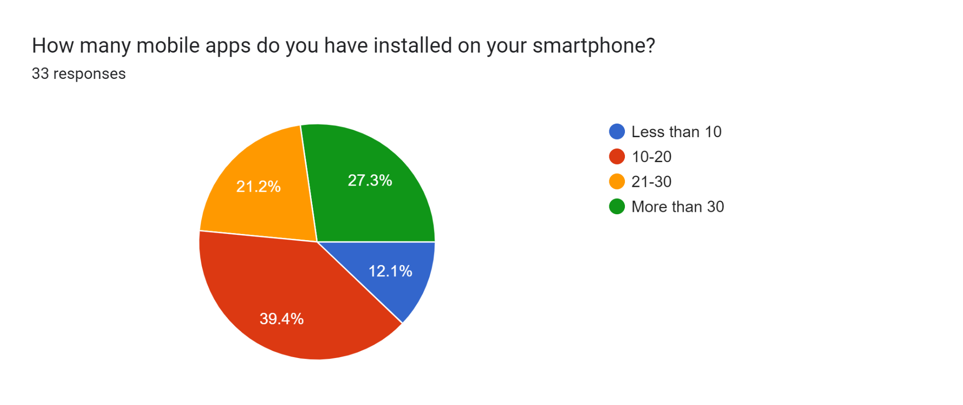
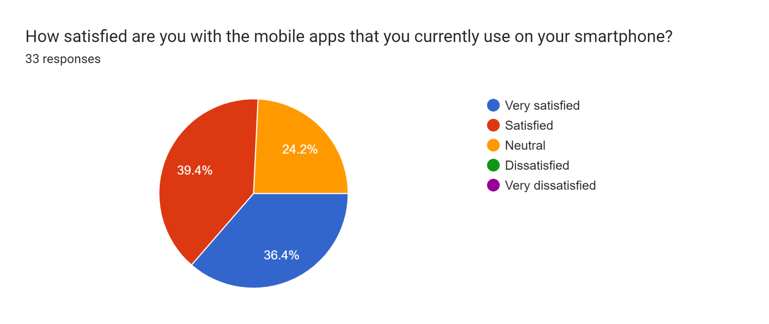
Results
Notes:
laiba

Slide 7
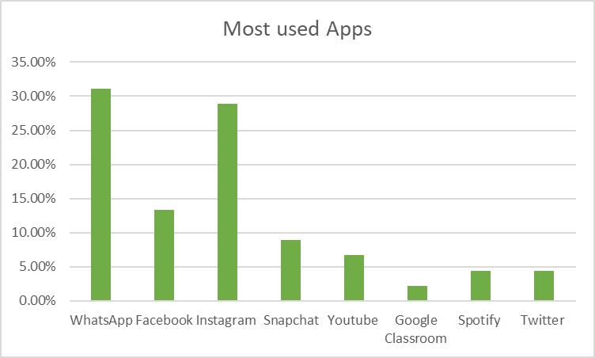
Notes:
laiba

Slide 8
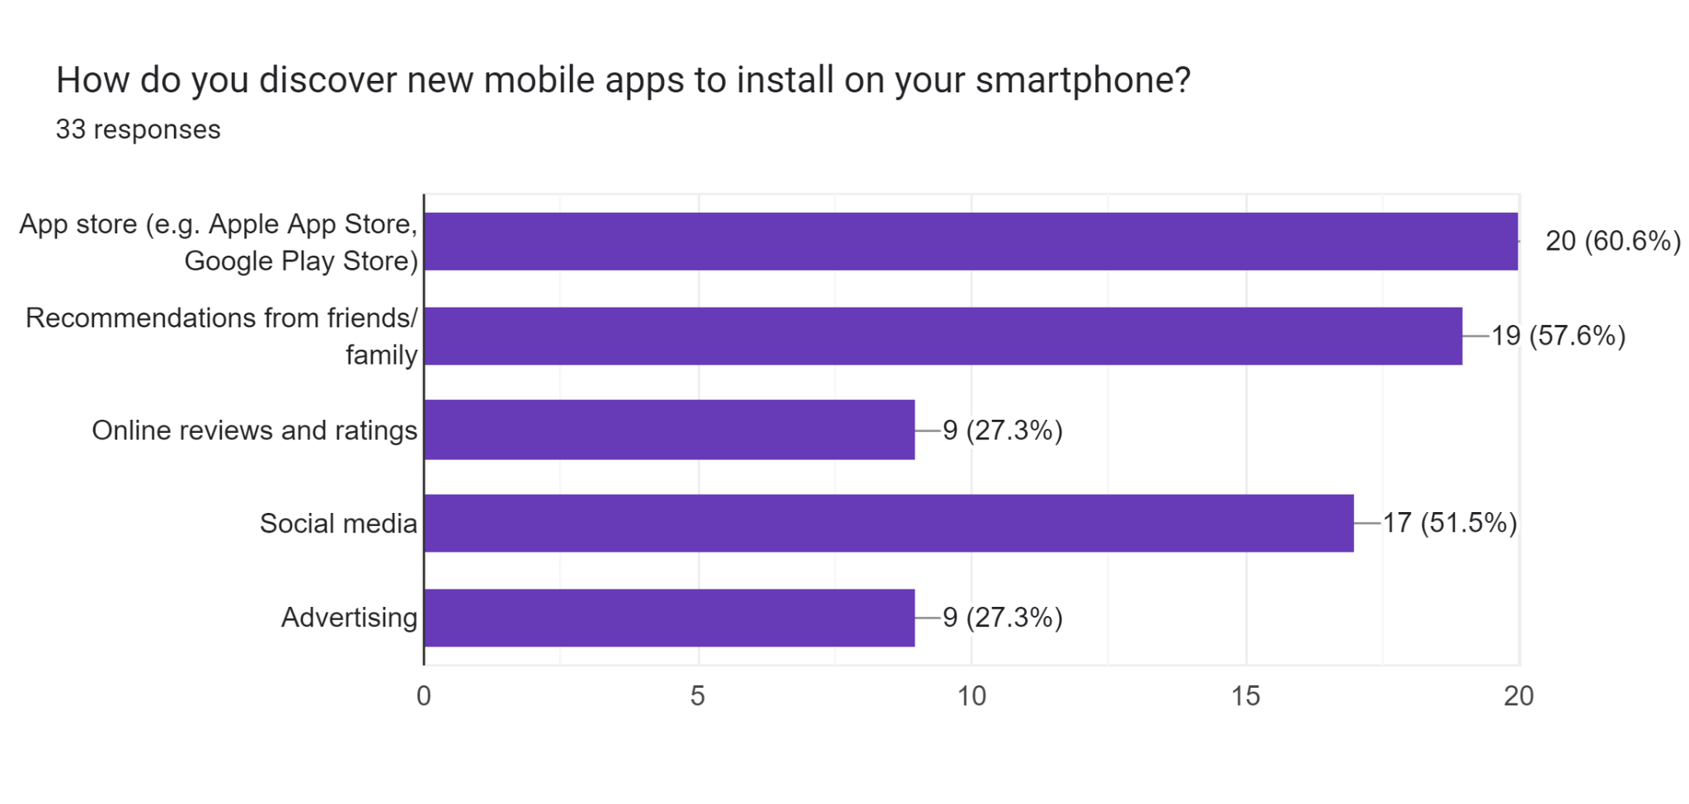
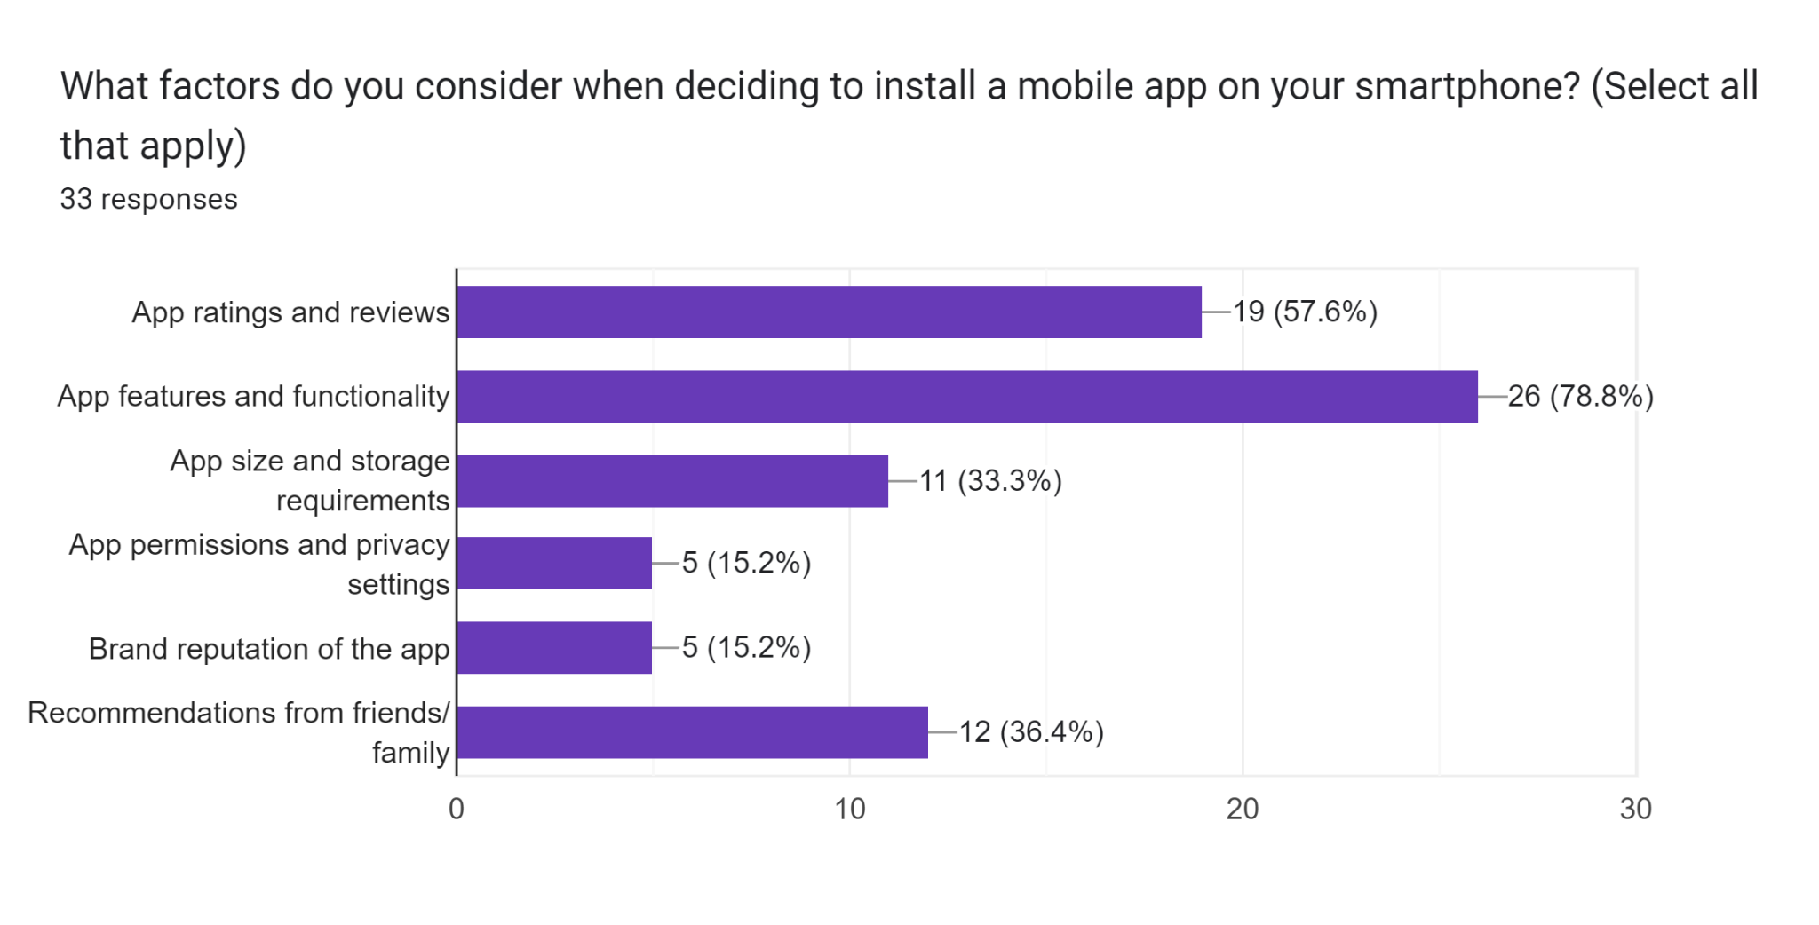
Notes:
laiba

Slide 9
Have you ever uninstalled any app on your smartphone? If yes, then why did you uninstall the app?
Got bored, didn't have a usage of it anymore
Because either I find it time consuming or boring
If it crashes ,or if I run out of storage.
Glitch
Not in use for a long time.
Google Meet, Messenger, many games
Irrelevant Ads
It wasn't up to the mark
Have no good features
Poor performance
Become boring or useless over time
Ran out of storage
Notes:
laiba

Slide 10
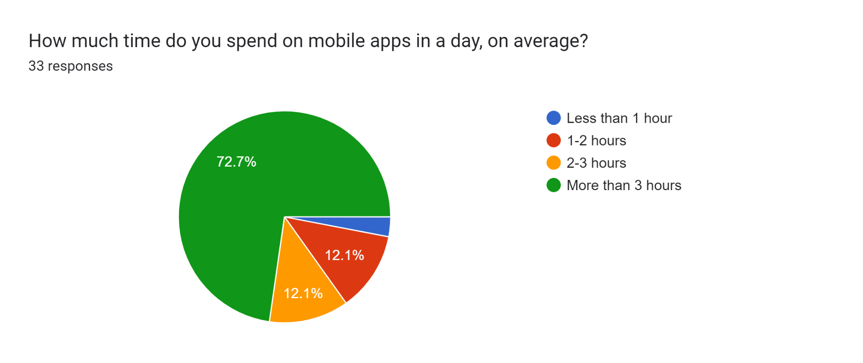
Notes:
laiba

Slide 11
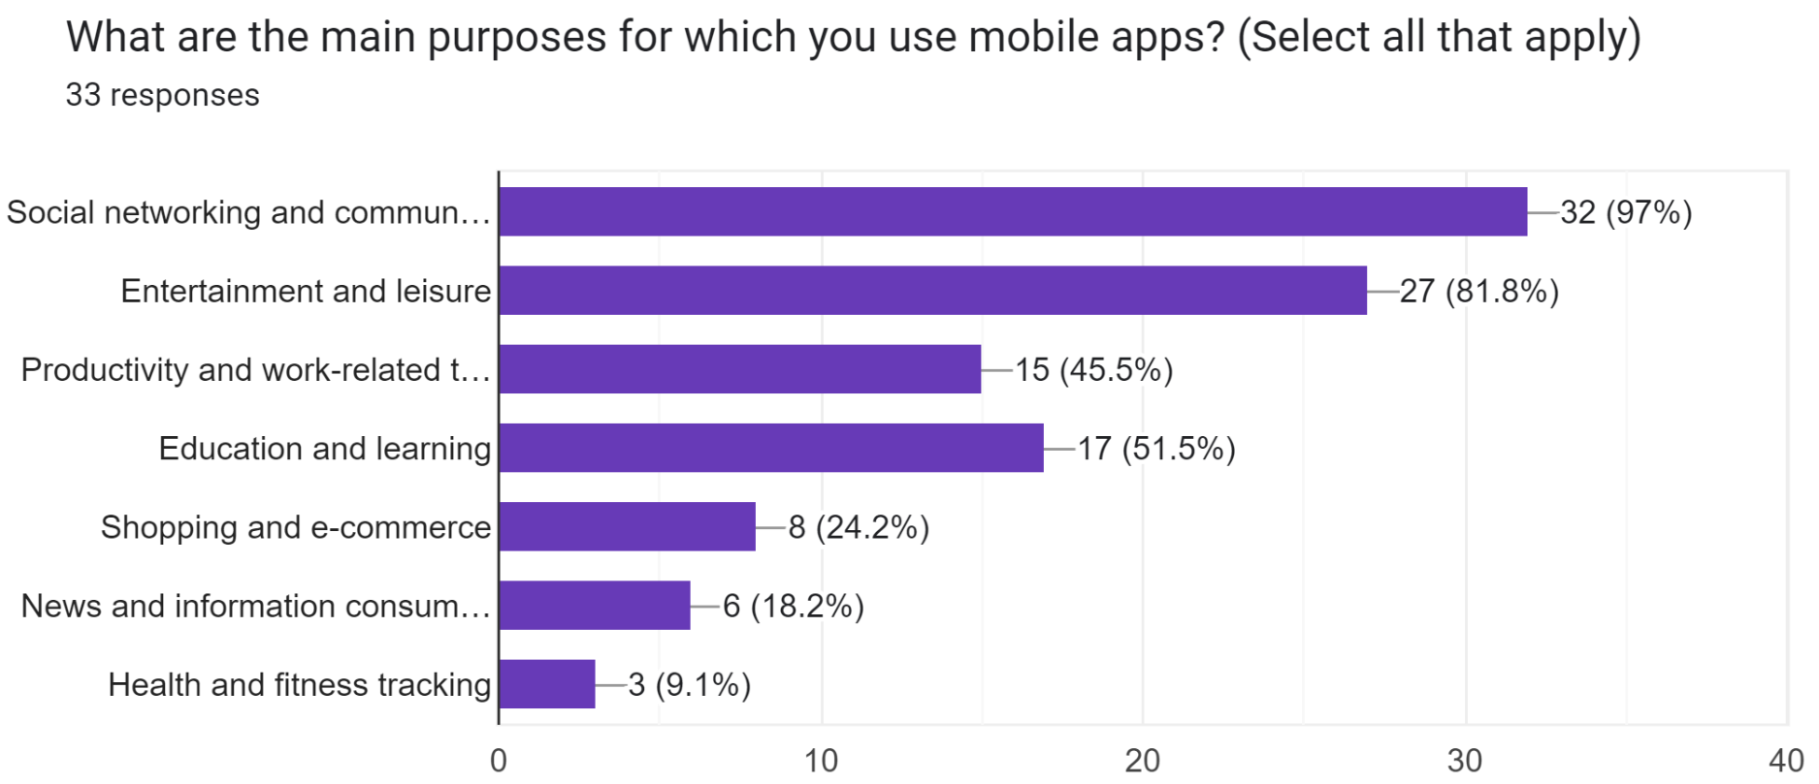
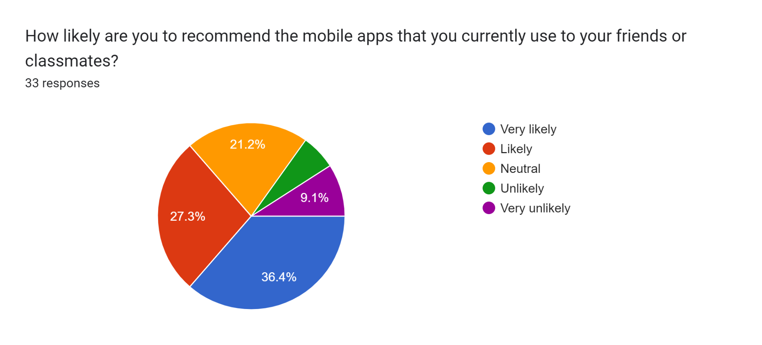
Notes:
laiba

Slide 12
What improvements or additional features would you like to see in the mobile apps that you currently use?
None
Google Classroom could be more better
Offline availability
In C compiler additional features must be there
Performance
Satisfied .
I wish the apps weren't so laggy.
Response time
WhatsApp: call option on whatsapp web
Bug fixes
More user friendly
As users like to have control over the look and feel of the app they are using so some more customization options , should be provided such as themes and new fonts.
There should be no country specific restrictions
Efficiency and free for students
Less advertisements
Nice UI
Restricted screen time

Slide 13
Conclusion
1. Most used apps
4. Number of apps installed
Instagram
Whatsapp
Youtube
About 39% students have 10 to 20 apps
About 21 % students have 20 to 30 apps
12 % have less than 10 apps
Rest have more than 30
2. Purpose for using these apps
Social networking
Education and learning
Productivity and Entertainment
5. Time spent
Maximum spend more than 3 hours
12.1% psend 2 to 3 hours mostly
12.1% spend 1 to 2 hours only
3. Benefits of using them
Time management
Personal interest
Productivity increases
Educational Purpose

Slide 14
Continued…
Time Management
Installation
Students reported using apps to manage their daily schedules.
Student consider apps based on their features and functionality, ratings and suggestions from friends .
Students Suggestions
Discovering Apps
Most of the students suggested to not rely on these mobile apps and use them in limits
Through reference from friends, online ratings and social advertising

Slide 15
THANKYOU!

